Slide 1
Stack & Queue
Notes:
https://www.w3resource.com/c-programming-exercises/linked_list/index.php
http://www.ggu.ac.in/download/IT/Inf%20Tech%20Pankaj%20Chandra%20B%20Tech%20%20IV%20Data%20Structure%20-%20Model%20Answer.pdf

Slide 2
queue data structure
Like Stack, Queue is a linear structure which follows a particular order in which the operations are performed. The order is First In First Out (FIFO).
A good example of queue is any queue of consumers for a resource where the consumer that came first is served first.
The difference between stacks and queues is in removing. In a stack we remove the item the most recently added; in a queue, we remove the item the least recently added.
Operations on Queue: Mainly the following four basic operations are performed on queue:
Enqueue: Adds an item to the queue. If the queue is full, then it is said to be an Overflow condition. Dequeue: Removes an item from the queue. The items are popped in the same order in which they are pushed. If the queue is empty, then it is said to be an Underflow condition. Front: Get the front item from queue. Rear: Get the last item from queue.

Slide 3
Queue Operations
enqueue
QUEUE
dequeue
create
isempty
size

Slide 4
QUEUE: First-In-First-Out (LIFO)
void enqueue (queue *q, int element);
/* Insert an element in the queue */
int dequeue (queue *q);
/* Remove an element from the queue */
queue *create();
/* Create a new queue */
int isempty (queue *q);
/* Check if queue is empty */
int size (queue *q);
/* Return the no. of elements in queue */

Slide 5
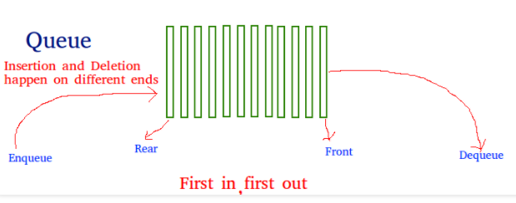
queue data structure
Applications of Queue: Queue is used when things don’t have to be processed immediately, but have to be processed in First In First Out order like Breadth First Search. This property of Queue makes it also useful in following kind of scenarios.
1) When a resource is shared among multiple consumers. Examples include CPU scheduling, Disk Scheduling. 2) When data is transferred asynchronously (data not necessarily received at same rate as sent) between two processes. Examples include IO Buffers, pipes, file IO, etc.

Slide 6
queue implementation using array and linked list
Refer Programs here

Slide 7
Applications of Queue
Real-world uses of queue data structures include call centers, printer management, traffic systems, task scheduling, and breadth-first search algorithms, enabling organized data handling and resource allocation.

Slide 8
Problem With Array Implementation
The size of the queue depends on the number and order of enqueue and dequeue.
It may be situation where memory is available but enqueue is not possible.
ENQUEUE
DEQUEUE
Effective queuing storage area of array gets reduced.
N
front
rear
Use of circular array indexing

Slide 9
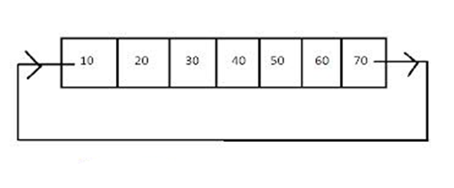
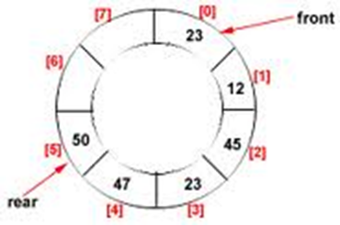
Circular Queue
In circular queue, the elements are physically arranged in sequential manner but logically they are treated as they are circularly arranged.

Slide 10
The rear and front move about in clockwise direction.
Circular queue is another form of a linear queue in which last position is connected to the first position of the list.
It can be viewed as a mesh or loop of wire , in which the two ends of the wire are connected together.
A circular queue is one in which the first element comes just after the last element.

Slide 11
The front will always be pointing to the first element.
If front=rear , the queue will have a single element.
Each time a new element is inserted into the queue the rear is incremented by one (rear=rear+1)
Each time an element is deleted from the queue the value of front is incremented by one (front=front+1)

Slide 12
Circular queue v/s Linear queue
Queues that have a fixed capacity are called bounded queues. In practical usage queues are bounded.
Circular queues have a fixed size, like bounded queues.
The end of a linear queue points to NULL indicating the end of the queue, while the end of a circular queue points to the beginning of the queue, thus completing the circle.
Linear queues do not allow overwriting of existing data. When the queue is full, new data cannot be inserted until old data is freed. Linear queues must pass both “Queue Empty” test before dequeue operation and “Queue Full” test before enqueue operation.
Circular queues are only required to pass “Queue Empty” test, and depending on the application the “Queue Full” test is optional. When new data is enqueued into a circular queue, the oldest data of the queue is overwritten.

Slide 13
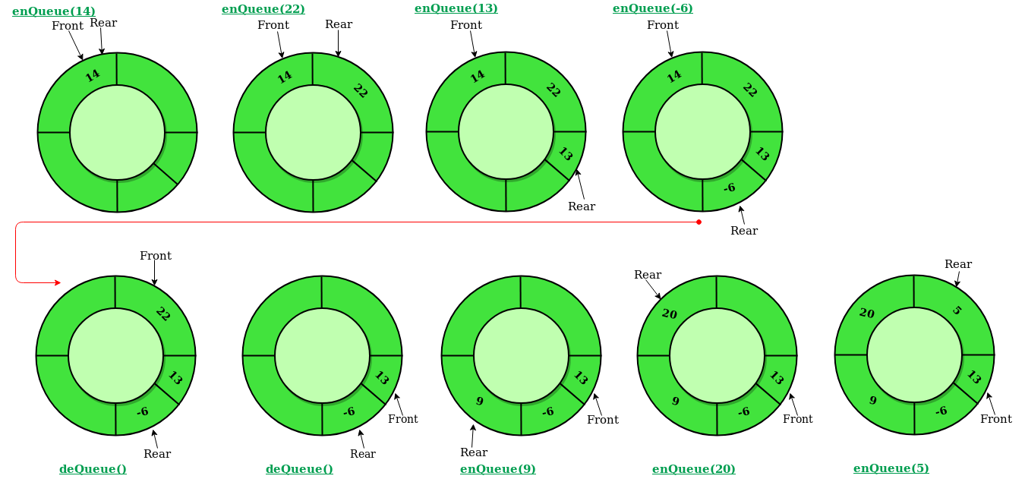
Circular Queue Operations

Slide 14
Algorithm to insert an element in a circular queue
Insert-Circular-Q(CQueue, Rear, Front, N, Item)
CQueue is a circular queue where to store data.
Rear represents the location in which the data element is to be inserted and Front represents the location from which the data element is to be removed.
Here N is the maximum size of CQueue and finally, Item is the new item to be added.
Initailly Rear = -1 and Front = -1.
1. If Front = -1 and Rear = -1 then Set Front := 0 and go to step 3.
2. If Front = (Rear + 1)%size then Print: “Circular Queue Overflow” and Return.
3. Set Rear := Rear + 1
4. Set CQueue [Rear] := Item.
5. Return

Slide 15
Algorithm to Delete an element in a circular queue
Delete-Circular-Q(CQueue, Front, Rear, Item)
Here, CQueue is the place where data are stored. Rear represents the location in which the data element is to be inserted and Front represents the location from which the data element is to be removed. Front element is assigned to Item. Initially, Front = -1.
1. If Front = -1 then Print: “Circular Queue Underflow” and Return. /*..Delete without Insertion
2. Set Item := CQueue [Front]
3. If Front = N-1 then Set Front = 0 and Return.
4. If Front = Rear then Set Front = -1 and Rear = -1 and Return.
5. Set Front := Front + 1
6. Return.

Slide 16
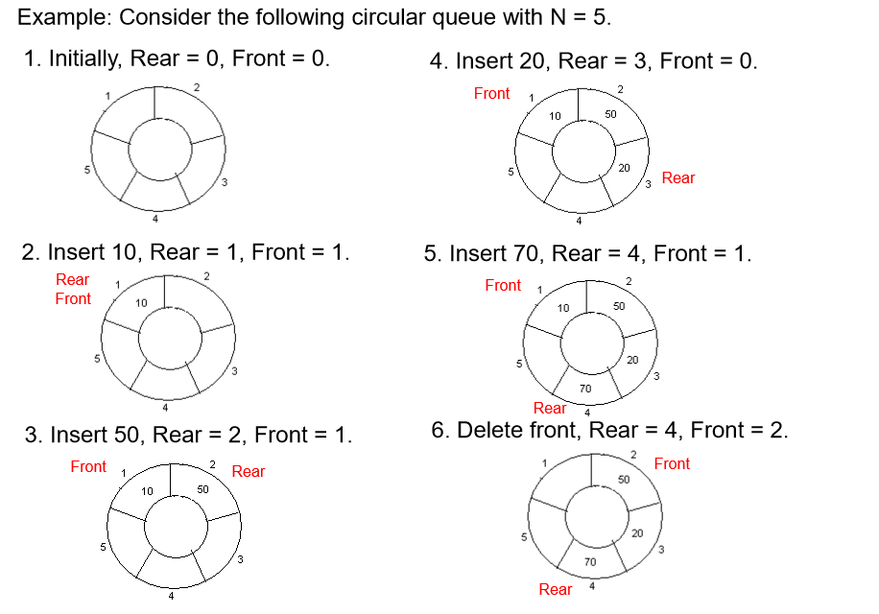

Slide 17
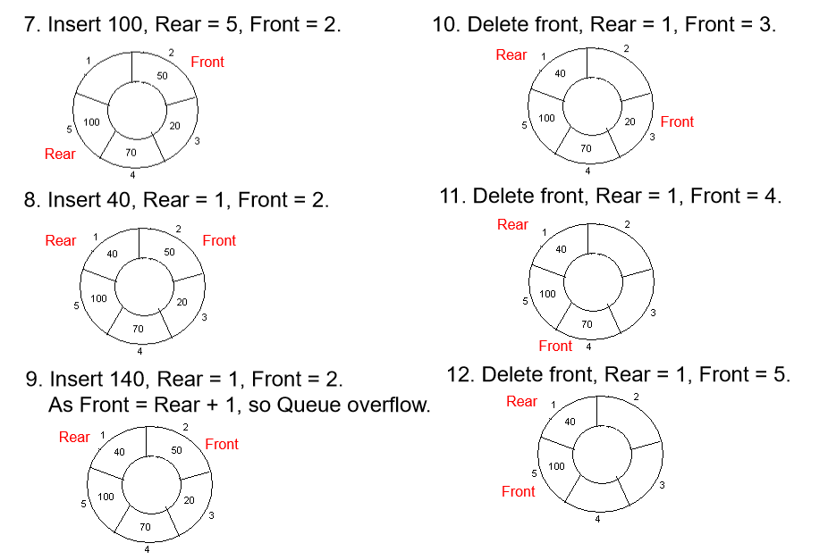

Slide 18
Insertion
qfull() {
if(front==(rear+1)%size) /* why % size is required? */
return 1;
else
return 0;
}
int insert(intitem) {
if(qfull())
printf("circular q is full");
else {
if(front = = -1)
front=rear=0;
else
rear=(rear+1)%size;
que[rear]=item; } }

Slide 19
Deletion
int qempty() {
if(front==-1)
return 1;
else
return 0;
}
int delete() {
int item;
if(qempty())
printf("queue is empty");
else {
item=que[front];
if(front==rear)
front=rear=-1;
else
front=(front+1)%size;
printf("the deleted item is%d ",item);
}
}

Slide 20
Display
void display() {
if(qempty()) {
printf("queue is empty");
return;
}
Int i=front
while(i!=rear) {
printf(“%d”,que[i]);
i=(i+1)%size;
}
Printf(“%d”,que[i]);
}

Slide 22
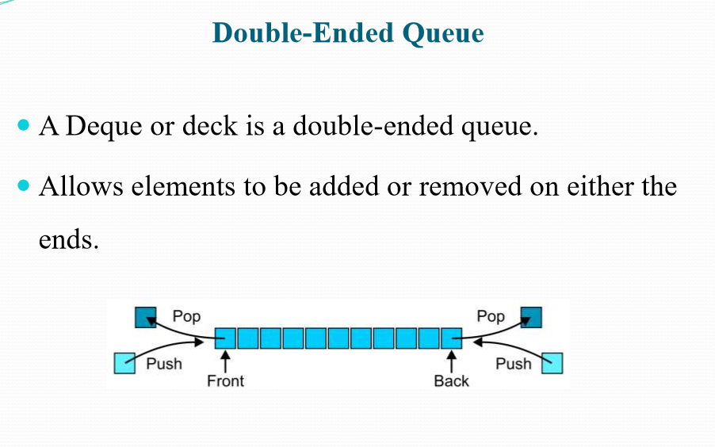
Double ended queue

Slide 23
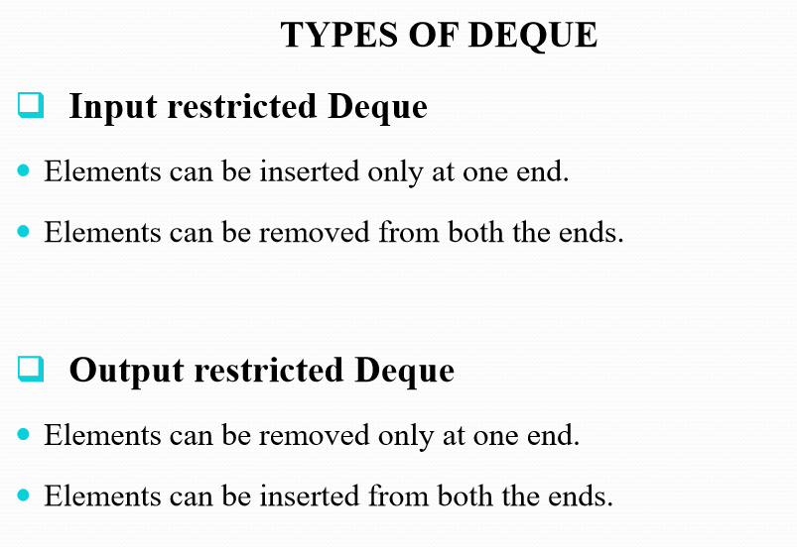

Slide 24
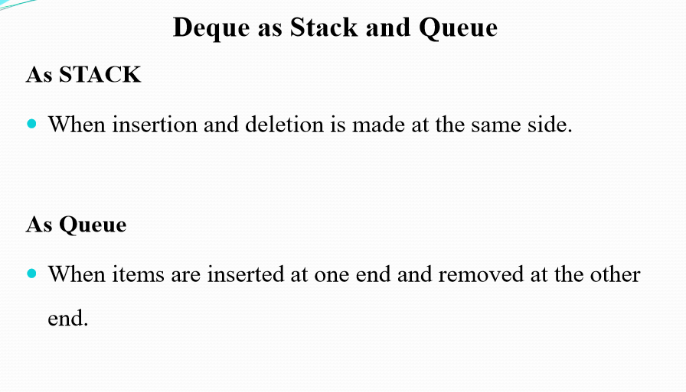

Slide 25
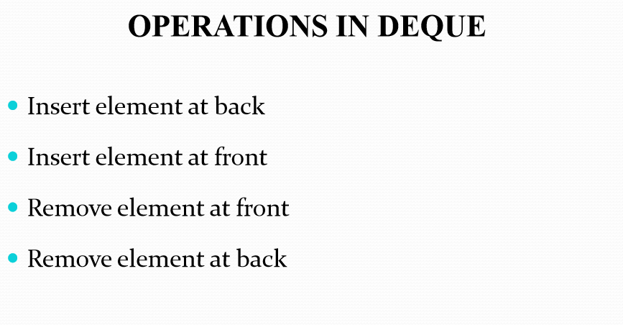

Slide 26
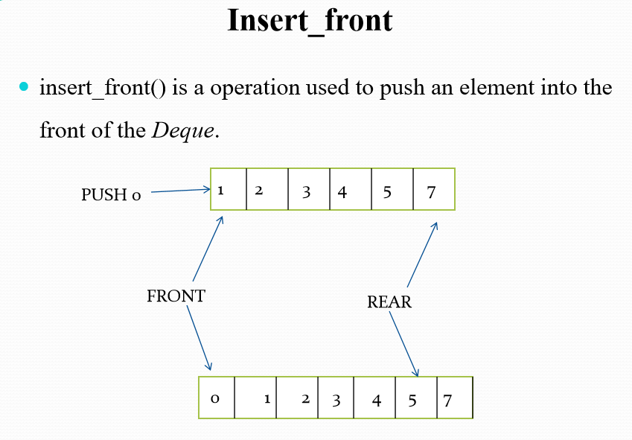
If queue is empty then we can insert otherwise it will give overflow error
Notes:
Output restricted

Slide 27
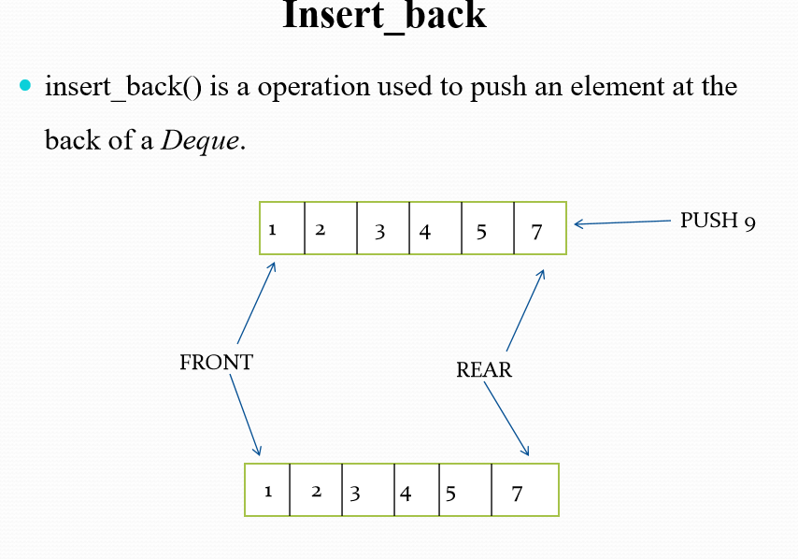
Notes:
Input restricted

Slide 28
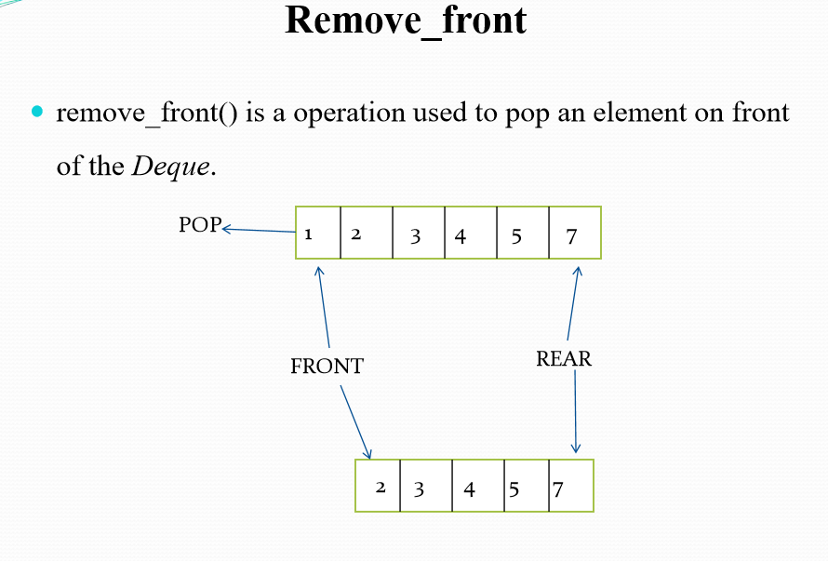
Notes:
Output restricted

Slide 29

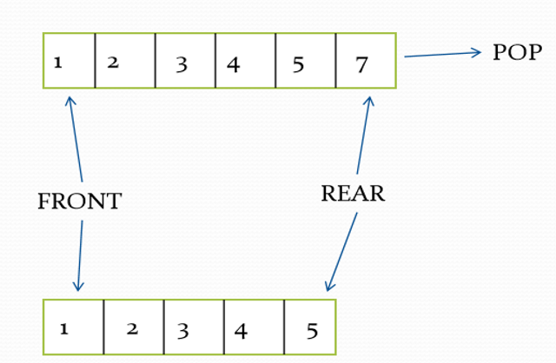
Remove_back() is an operation used to pop an element at back of the Deque.
Notes:
Input restricted

Slide 30
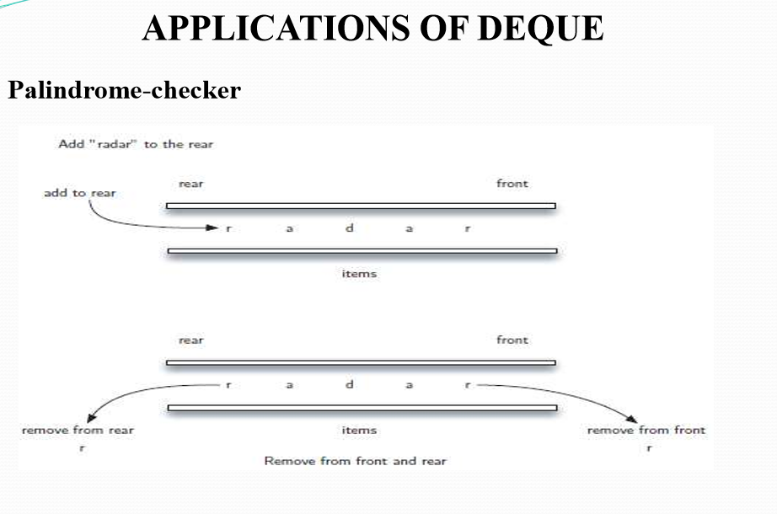

Slide 31
C Program

Slide 32
Priority Queue
A priority queue is a type of queue that arranges elements based on their priority values. Elements with higher priority values are typically retrieved before elements with lower priority values.
In a priority queue, each element has a priority value associated with it. When you add an element to the queue, it is inserted in a position based on its priority value.
Key Characteristics of a Priority Queue:
Ordering Principle: Elements are ordered based on their priority values. The element with the highest priority is served first.
No Fixed Order: Unlike a regular queue, there is no fixed order (e.g., First-In-First-Out or Last-In-First-Out) for removing elements. The removal is based on the priority of the elements.

Slide 33
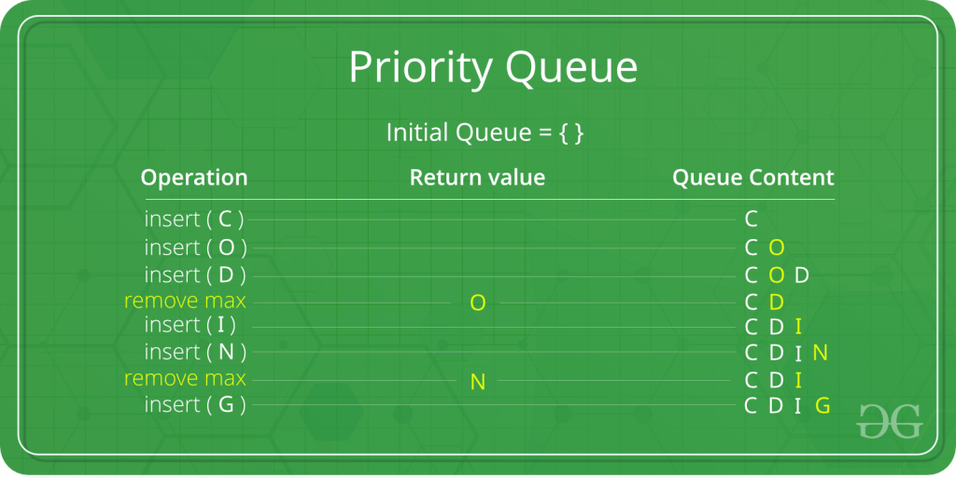
Properties of Priority Queue
So, a priority Queue is an extension of the queue with the following properties.
Every item has a priority associated with it.
An element with high priority is dequeued before an element with low priority.
If two elements have the same priority, they are served according to their order in the queue.
In the below priority queue, an element with a maximum ASCII value will have the highest priority. The elements with higher priority are served first.

Slide 34
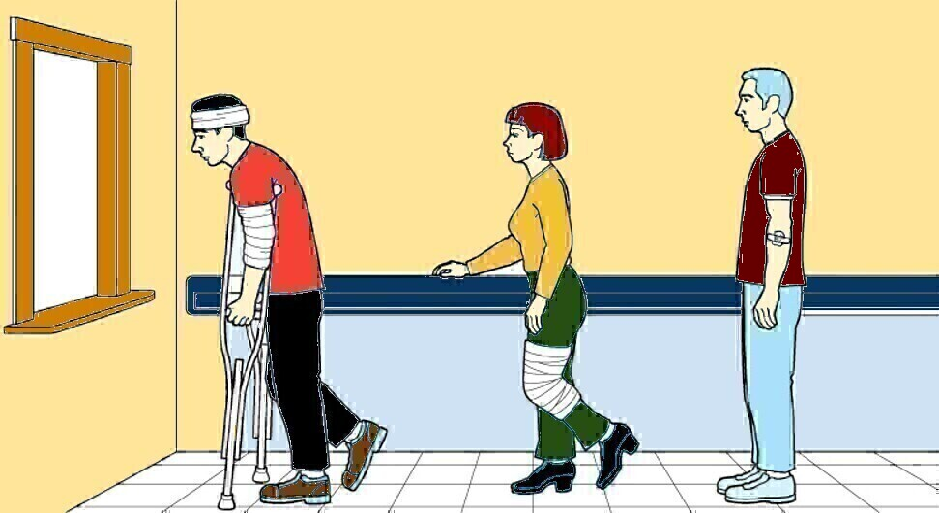
Priority Queue
Priority Queue
An abstract data type in which only the item with the highest
priority can be accessed.

Slide 35
Operations of a Priority Queue:
A typical priority queue supports the following operations:
1) Insertion in a Priority Queue
2) Deletion in a Priority Queue
3) Peek in a Priority Queue

Slide 36
Difference between Priority Queue and Normal Queue?
There is no priority attached to elements in a queue, the rule of first-in-first-out(FIFO) is implemented whereas, in a priority queue, the elements have a priority. The elements with higher priority are served first.

Slide 37
Implement Priority Queue Using Array:
A simple implementation is to use an array of the following structure.
struct item { int item; int priority; }
enqueue(): This function is used to insert new data into the queue.
dequeue(): This function removes the element with the highest priority from the queue.
peek()/top(): This function is used to get the highest priority element in the queue without removing it from the queue.
Arrays | enqueue() | dequeue() | peek()
Time Complexity | O(1) | O(n) | O(n)

Slide 38
Implement Priority Queue Using Linked List:
In a Linked List implementation, the entries are sorted in descending order based on their priority. The highest priority element is always added to the front of the priority queue, which is formed using linked lists. The functions like push(), pop(), and peek() are used to implement a priority queue using a linked list and are explained as follows:
push(): This function is used to insert new data into the queue.
pop(): This function removes the element with the highest priority from the queue.
peek() / top(): This function is used to get the highest priority element in the queue without removing it from the queue.
Linked List | push() | pop() | peek()
Time Complexity | O(n) | O(1) | O(1)

Slide 39
Implement Priority Queue Using Heaps:
Binary Heap is generally preferred for priority queue implementation because heaps provide better performance compared to arrays or LinkedList. Considering the properties of a heap, The entry with the largest key is on the top and can be removed immediately. It will, however, take time O(log n) to restore the heap property for the remaining keys. However if another entry is to be inserted immediately, then some of this time may be combined with the O(log n) time needed to insert the new entry. Thus the representation of a priority queue as a heap proves advantageous for large n, since it is represented efficiently in contiguous storage and is guaranteed to require only logarithmic time for both insertions and deletions.
Operations on Binary Heap are as follows:
Insert(p): Inserts a new element with priority p.
extractMax(): Extracts an element with maximum priority.
getMax(): Returns an element with maximum priority.
Binary Heap | insert() | remove() | peek()
Time Complexity | O(log n) | O(log n) | O(1)

Slide 40
Heap
Heap is a complete binary tree.
Parent will be greater than their child.
In max heap, maximum element is at the root
In min heap, minimum element is at the root
* Detailed discussion on Heaps will be in Unit 4

Slide 41
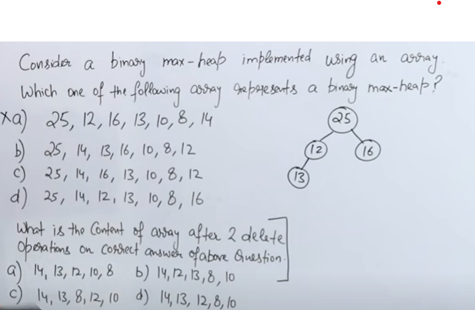
Gate 2009
Notes:
Ans C
Ans D

Slide 42
Implement Stack Using 2 Queues
Push (x)
→ enqueue x to Q2
→ Copy element by element from Q1 to Q2
→ enqueue Q2→Q1
Time: O(n)
Pop
→ Remove the top from Q1
Time: O(1)
Space complexity overall: O(n)

Slide 43
Implement Stack using single queue
https://www.geeksforgeeks.org/implement-a-stack-using-single-queue/
Drawbacks
Memory wastage
Time complexity will be O(n²)

Slide 44
Implement Queue using Stacks
Push (X)
Transfer S1→S2
X→S1
Transfer S2→S1
Time: O(n)
Pop (X)
Remove the top from S1
Time: O(1)
Space complexity overall: O(n)

Slide 45
Lab Experiments
Using array and linkedlist implement Queue data structure and its operations like insert, delete, and display.
Check whether the string is palindrome or not using array and Queue.
Using array and functions implement Circular Queue data structure and its operations like insert, delete, and display.
Using array and functions implement a Stack using Queues.

Slide 46
Practice Questions
https://www.geeksforgeeks.org/quizzes/top-mcqs-on-queue-data-structure-with-answers/

Slide 47
GeeksforGeeks Interview Questions on Stack and Queue
Stack and queue are two different elements in computer programming. Static is usually a container of objects that are supposed to be inserted or removed according to the LIFO principle. While queue is a container of objects in a linear collection that is supposed to be inserted and removed according to the FIFO principle. Here are some commonly asked data structure GeeksforGeeks questions in a coding interview :-
Application of parenthesis checker
Creation of a queue using two stacks
Creation of a stack using two queues
Deletion of middle element of stack

Slide 48
Top 50 Problems on Stack Data Structure asked in SDE Interviews
https://www.geeksforgeeks.org/top-50-problems-on-stack-data-structure-asked-in-interviews/

Slide 49
Top 50 Problems on Queue Data Structure asked in SDE Interviews
https://www.geeksforgeeks.org/top-50-problems-on-queue-data-structure-asked-in-sde-interviews/

